Slide 1
IBM University Engagement Project Submission
“Exploring the Power of Agentic AI with IBM Granite and LangFlow”

Slide 2

Project Tile – [ Thai Recipe Guidance ]
Domain of Project – [Food]
Faculty Name | Recent Passport Photo | Email ID | Mobile number [WhatsApp]
Nitin Tripathi |  | nitintripathi79@gmail.com | 8373911665

Slide 3
Problem Statement -
Problem Statement : Thai Recipe Agent
Develop an AI-powered conversational agent that provides users with authentic Thai cooking instructions, ingredient insights, substitutions, and culinary context, acting as a personal, knowledgeable Thai cooking assistant .
Key Challenges to Address
Authenticity and Standardization: Navigating the lack of standardized definitions in Thai cuisine to provide authentic, high-quality recipes rather than diluted interpretations .
Regional Diversity: Recognizing that Thai food varies significantly across four main regions (North, Northeast, Central, South), each with unique ingredients and traditions.
Dynamic Ingredient Management: Solving the issue of missing ingredients by recommending appropriate, authentic substitutes based on taste, smell, and texture (e.g., swapping out shallots for red onions or lime for tamarind).
Balancing Flavors: Assisting users in balancing the five fundamental Thai tastes: salty, sweet, sour, spicy, and creamy.
Core Functionalities of the Agent
Knowledge Retrieval: Utilizing a specialized knowledge base of authentic recipes.
Natural Language Interaction: Answering questions such as "How do I make authentic Pad Thai?" or "What's the difference between red and green curry?".
Ingredient Substitutions: Suggesting alternatives based on availability.
Technique Guidance: Explaining, for example, how to prevent coconut milk from separating in curry.
Potential Use Cases
Home Cooking Assistant: Helping users prepare meals by providing step-by-step guidance.
Learning Platform: Educating users on the history and culture behind dishes like Tom Yum.
Meal Planner: Assisting in ingredient sourcing and meal planning based on dietary preferences (e.g., vegan/vegetarian adaptations).
Expected Outcome A robust, interactive agent that enhances the user's ability to cook authentic Thai food at home, effectively bridging the gap between traditional recipes and modern convenience

Slide 4
Technology Used
Tech Stack (Mandatory)
I use the following approaches:
LangFlow + IBM watsonx.ai + Granite Models

Slide 5
Proposed Solution -
Proposed Solution: Thai Recipe Agent
Thai recipes focus on balancing the five core flavors—sour, bitter, salty, sweet, and spicy—using accessible ingredients while maintaining authenticity . Key solutions for common challenges include using curry paste to build flavor, managing heat levels, and utilizing fresh herbs for aroma.
Key Solutions for Authentic Thai Cooking
Balancing Flavors: The core of Thai cuisine is balancing lime (sour), fish sauce (salty), palm sugar (sweet), and chilies (spicy) .
The Secret Weapon (Nam Prik Pao): Thai chili paste (nam prik pao) can be added to fried rice and stir-fries to provide instant sweet umami flavor, notes.
Making Curry Paste: For Green Curry, making paste from scratch using green chilies, lemongrass, galangal, makrut lime peel, and shrimp paste is recommended for better texture.
Adjusting Spice Level: If a curry is too hot, mellow it by adding fat (coconut milk), sugar, or acidity (lime juice).
Easy Ingredient Substitutions: If palm sugar is unavailable, use brown sugar. If galangal is unavailable, use ginger (though it will change the flavor slightly).
Simplifying Pad Thai: Instead of complex traditional methods, use tamarind paste, fish sauce, and palm sugar for the base sauce.

Slide 6
Langflow component Used -
1) Chat Input – Interface where users enter their queries, preferences, or meal details (text/voice/image).
2) IBM watsonx AI Agent - Processes user input using Granite models to generate personalized nutrition insights and recommendations.
3) Name of IBM Granite model – ibm/granite-4-h-small → Fast, efficient for real-time diet recommendations
4) Chat output -Displays AI-generated responses such as diet plans, nutritional analysis, and health suggestions.
5) File component - Stores and retrieves user data , meal logs, and ThaiRecipe.pdf file as a knowledge base for analysis and tracking.

Slide 7
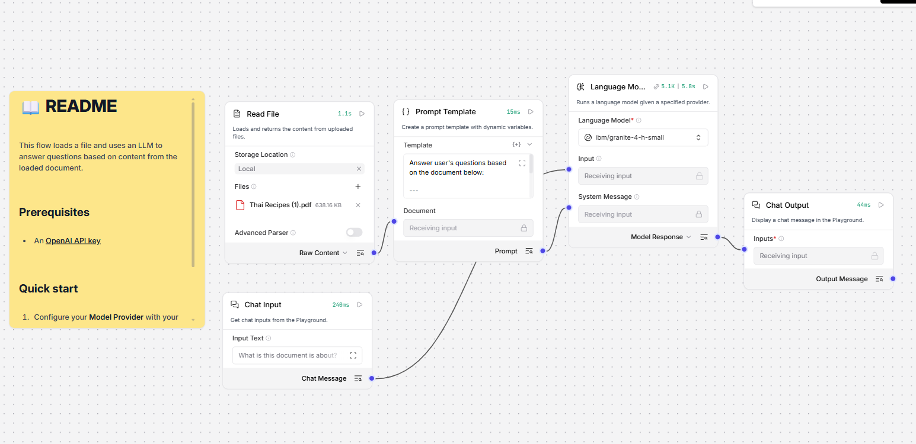
Langflow workflow -

Slide 8

Architecture blueprint

Slide 9

Role of Agentic AI in the solution
Role of Agentic AI in Thai Recipe Agent
Agentic AI in a Thai Recipe Agent elevates it from a passive recipe database into an autonomous kitchen assistant that plans, acts, and learns, mimicking the skills of a Thai chef rather than just searching for text . While generative AI might create a recipe, an agentic system executes the entire workflow, from checking inventory to adapting flavors.
Here is the role of Agentic AI in a Thai Recipe Agent:
. Goal-Oriented Planning and Reasoning
Instead of providing a one-off recipe, an agentic Thai assistant breaks down complex goals.
Menu Planning: You ask for a "complete Northern Thai dinner." The agent plans courses that balance flavors and textures (e.g., pairing Khao Soi with sour pickles) .
Constraint Handling: The agent respects limitations, such as finding a "dairy-free, low-sodium Tom Yum" or adjusting for available ingredients (e.g., substituting Thai basil for Holy basil)

Slide 10
Technology Used
Langflow platform -For designing and orchestrating multi-agent workflows visually
IBM Grainte model - for eg – ibm-granite-4h-small – For natural language understanding, reasoning, and personalization
IBM Cloud – It provides the infrastructure to build, deploy, and scale the Thai Recipe Agent efficiently. IBM Cloud enables a reliable, secure, and scalable environment for deploying the Thai Recipe Agent.
RAG– RAG to fetch real data first, then generate intelligent answers, making the Thai Recipe Agent more trustworthy and effective.
IBM Watsonx.ai - For model deployment, embeddings, and AI governance

Slide 11
Novelty and Uniqueness
The proposed Nutrition Agent stands out by combining Agentic AI, RAG, and personalization into a single intelligent system.
Single-Agent Intelligence –single chatbot, agents collaborate to deliver accurate and context-aware Recipe.
RAG-Based Accuracy – Integrates real-time data retrieval with AI generation, reducing misinformation and ensuring trustworthy recommendations.
Hyper-Personalization – Tailors diet plans based on health conditions, cultural preferences, and fitness goals.
Real-Time Feedback Loop – Continuously adapts recommendations based on daily food logs and user behaviour.
Multi-Modal Input – Supports text, voice, and image-based meal tracking for better usability.
Preventive Healthcare Focus – Goes beyond diet planning to provide disease-specific nutrition advice.
Scalable & Enterprise-Ready – Built on IBM watsonx.ai with IBM Granite models, ensuring reliability and governance.
This makes the solution a smart, adaptive, and proactive Recipe Maker, not just a static diet recommendation tool.

Slide 12
Git Hub Link (Change Later)
Github URL –https://github.com/nitintripathi79/SRMIST_ThaiRecipe_NitinTripathi
File Uploaded in Github
Nitin Tripathi Certificate.pdf
Json File -Thai Receipe Guidance.json file
Power point presentation:- Nitin Tripathi Project Submission.pptx
·
·

Slide 13
Future Scope
The future scope for a Thai Recipe Agent (AI-powered tool, digital platform, or culinary assistant) is exceptionally strong, driven by the rapid growth of Thailand's culinary tourism market, which is projected to reach USD 179.4 billion by 2034 .
As Thai cuisine remains a key part of Thailand's soft power, opportunities for AI recipe agents are expanding across the following areas
AI-Powered Personalization and Smart Recipe Systems.
Gastrodiplomacy and Global Expansion.
FoodTech and Sustainability.
Expansion in Key International Markets.
Enhanced Ingredient Accessibility.

Slide 14


